Slide 1

Week 2 Variables, Expressions, Statements, and Conditionals
Ian M Rambo
Code Clubhouse – Python for Everybody
05/13/2020
@Ian Rambo

Slide 2

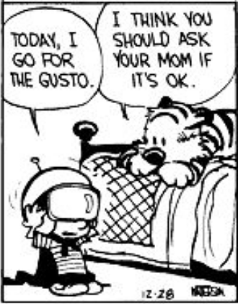




Ready to go?
Anaconda or Miniconda
Jupyter (ideally JupyterLab)
Slack
Zoom
A modern internet browser (Firefox or Chrome are good bets)
Google Account (for accessing Google Drive)

Slide 3
A few Zoom notes…
Sign into your Zoom account before joining a meeting
Mute your microphone when not speaking
Use the “Raise Hand” feature to ask live questions
Use Screen Sharing if you want to demonstrate code live
Do not post Zoom links outside of the Slack workspace for security reasons
Webinars will be recorded as .mp4, and uploaded to Google Drive

Slide 4
A few Slack notes…
Download the Slack app for your phone
Google Play Store (Android)
App Store (iOS)
I will post useful links in #resources
General questions and chat in #general
Specific code questions in #coding-classes-for-the-community
Use code formatting when posting code </>
Dank memes in #random

Slide 5
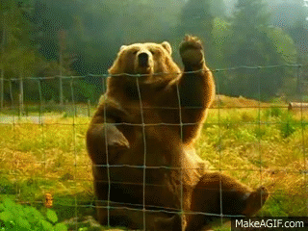
Please introduce yourself!

Slide 6



Nice to meet you!
Hometown: New Orleans
PhD Candidate in Marine Science, University of Texas at Austin Marine Science Institute
Lawrence Berkeley National Laboratory
Bioinformatician
Python allows me to…
Answer biological questions by analyzing large amounts of genomic sequence data
Do pretty much anything you put your mind to

Slide 7
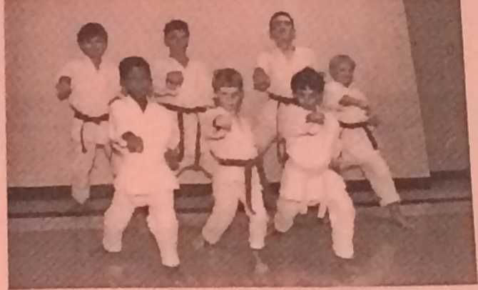
Forming a solid foundation
Review PY4E materials (posted in #resources)
Don’t be afraid to look ahead
Read the PEP8 style guide (#resources) – ”code unto others as you would have them code unto you”
Read the Manual (i.e. Python docs)
Python generally has a “best way” to do things
Recommended reading – The Pragmatic Programmer (20th Anniversary Edition) (Thomas & Hunt)
I might upload scans
Sensei Nikki always stressed… basics!

Slide 8
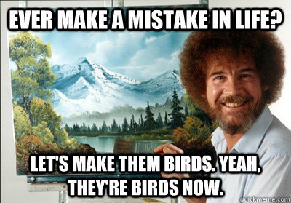
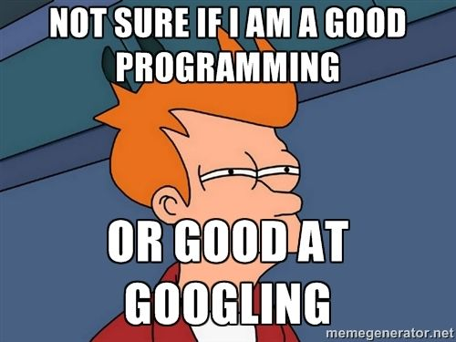
Failure is OK - learn to fail well and recover quickly
Don’t be afraid to experiment
Use ”disposable” environments whenever possible
Safety first
Laziness is a virtue
Somebody has had your problem before
StackOverflow

Slide 9
Let’s get started!
Start the Jupyter Notebook
Anaconda Navigator – use Jupyter icon
Command line (OSX, Linux) or Anaconda Prompt
cd to your working directory
jupyter notebook

Slide 10
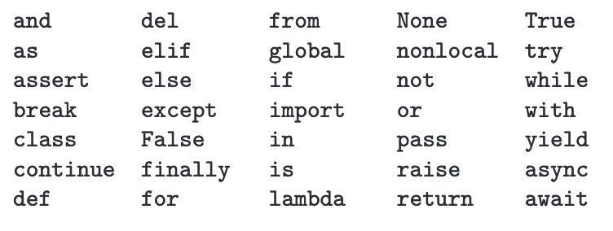
Python’s 35 special keywords
These cannot be used for variables (or functions, or classes, but we’ll get there)

Slide 11


Variables, Expressions, and Statements
Chapter 2
Python for Everybody
www.py4e.com
Notes:
Note from Chuck. If you are using these materials, you can remove the UM logo and replace it with your own, but please retain the CC-BY logo on the first page as well as retain the acknowledgement page(s) at the end.

Slide 12
Constants
Fixed values such as numbers, letters, and strings, are called “constants” because their value does not change
Numeric constants are as you expect
String constants use single quotes (') or double quotes (")
>>> print(123)
123
>>> print(98.6)
98.6
>>> print('Hello world')
Hello world

Slide 13
Reserved Words
You cannot use reserved words as variable names / identifiers
False class return is finally
None if for lambda continue
True def from while nonlocal
and del global not with
as elif try or yield
assert else import pass
break except in raise

Slide 14
Variables
A variable is a named place in the memory where a programmer can store data and later retrieve the data using the variable “name”
Programmers get to choose the names of the variables
You can change the contents of a variable in a later statement
12.2
x = 12.2
y = 14
x
14
y

Slide 15
Variables
A variable is a named place in the memory where a programmer can store data and later retrieve the data using the variable “name”
Programmers get to choose the names of the variables
You can change the contents of a variable in a later statement
12.2
x = 12.2
y = 14
x = 100
x
100
14
y

Slide 16
Python Variable Name Rules
Must start with a letter or underscore _
Must consist of letters, numbers, and underscores
Case Sensitive
Good: spam eggs spam23 _speed
Bad: 23spam #sign var.12
Different: spam Spam SPAM

Slide 17
Mnemonic Variable Names
Since we programmers are given a choice in how we choose our variable names, there is a bit of “best practice”
We name variables to help us remember what we intend to store in them (“mnemonic” = “memory aid”)
This can confuse beginning students because well-named variables often “sound” so good that they must be keywords
http://en.wikipedia.org/wiki/Mnemonic

Slide 18
x1q3z9ocd = 35.0
x1q3z9afd = 12.50
x1q3p9afd = x1q3z9ocd * x1q3z9afd
print(x1q3p9afd)
What is this bit of code doing?

Slide 19
x1q3z9ocd = 35.0
x1q3z9afd = 12.50
x1q3p9afd = x1q3z9ocd * x1q3z9afd
print(x1q3p9afd)
a = 35.0
b = 12.50
c = a * b
print(c)
What are these bits of code doing?

Slide 20
x1q3z9ocd = 35.0
x1q3z9afd = 12.50
x1q3p9afd = x1q3z9ocd * x1q3z9afd
print(x1q3p9afd)
a = 35.0
b = 12.50
c = a * b
print(c)
hours = 35.0
rate = 12.50
pay = hours * rate
print(pay)
What are these bits of code doing?

Slide 21
Sentences or Lines
x = 2
x = x + 2
print(x)
Assignment statement
Assignment with expression
Print statement
Variable
Operator
Constant
Function

Slide 22
Assignment Statements
We assign a value to a variable using the assignment statement (=)
An assignment statement consists of an expression on the right-hand side and a variable to store the result
x = 3.9 * x * ( 1 - x )

Slide 23
0.6
A variable is a memory location used to store a value (0.6)
x
0.6
0.6
x = 3.9 * x * ( 1 - x )
0.4
The right side is an expression. Once the expression is evaluated, the result is placed in (assigned to) x.
0.936

Slide 24
A variable is a memory location used to store a value. The value stored in a variable can be updated by replacing the old value (0.6) with a new value (0.936).
0.6 0.936
x
0.6
0.6
x = 3.9 * x * ( 1 - x )
0.4
The right side is an expression. Once the expression is evaluated, the result is placed in (assigned to) the variable on the left side (i.e., x).
0.936

Slide 25
Expressions…

Slide 26
Numeric Expressions
Because of the lack of mathematical symbols on computer keyboards - we use “computer-speak” to express the classic math operations
Asterisk is multiplication
Exponentiation (raise to a power) looks different than in math
Operator | Operation
+ | Addition
- | Subtraction
* | Multiplication
/ | Division
** | Power
% | Remainder

Slide 27
Numeric Expressions
>>> xx = 2
>>> xx = xx + 2
>>> print(xx)
4
>>> yy = 440 * 12
>>> print(yy)
5280
>>> zz = yy / 1000
>>> print(zz)
5.28
>>> jj = 23
>>> kk = jj % 5
>>> print(kk)
3
>>> print(4 ** 3)
64
Operator | Operation
+ | Addition
- | Subtraction
* | Multiplication
/ | Division
** | Power
% | Remainder
4 R 3
5
23
20
3

Slide 28
Order of Evaluation
When we string operators together - Python must know which one to do first
This is called “operator precedence”
Which operator “takes precedence” over the others?
x = 1 + 2 * 3 - 4 / 5 ** 6

Slide 29
Operator Precedence Rules
Highest precedence rule to lowest precedence rule:
Parentheses are always respected
Exponentiation (raise to a power)
Multiplication, Division, and Remainder
Addition and Subtraction
Left to right
Parenthesis
Power
Multiplication
Addition
Left to Right

Slide 30
1 + 2 ** 3 / 4 * 5
>>> x = 1 + 2 ** 3 / 4 * 5
>>> print(x)
11.0
>>>
1 + 8 / 4 * 5
1 + 2 * 5
Parenthesis
Power
Multiplication
Addition
Left to Right
1 + 10
11

Slide 31
Operator Precedence
Parenthesis
Power
Multiplication
Addition
Left to Right
Remember the rules top to bottom
When writing code - use parentheses
When writing code - keep mathematical expressions simple enough that they are easy to understand
Break long series of mathematical operations up to make them more clear

Slide 32
What Does “Type” Mean?
In Python variables, literals, and constants have a “type”
Python knows the difference between an integer number and a string
For example “+” means “addition” if something is a number and “concatenate” if something is a string
>>> ddd = 1 + 4
>>> print(ddd)
5
>>> eee = 'hello ' + 'there'
>>> print(eee)
hello there
concatenate = put together

Slide 33
Type Matters
Python knows what “type” everything is
Some operations are prohibited
You cannot “add 1” to a string
We can ask Python what type something is by using the type() function
>>> eee = 'hello ' + 'there'
>>> eee = eee + 1
Traceback (most recent call last): File "<stdin>", line 1, in <module>TypeError: Can't convert 'int' object to str implicitly
>>> type(eee)
<class'str'>
>>> type('hello')
<class'str'>
>>> type(1)
<class'int'>
>>>

Slide 34
Several Types of Numbers
Numbers have two main types
- Integers are whole numbers: -14, -2, 0, 1, 100, 401233
- Floating Point Numbers have decimal parts: -2.5 , 0.0, 98.6, 14.0
There are other number types - they are variations on float and integer
>>> xx = 1
>>> type (xx)
<class 'int'>
>>> temp = 98.6
>>> type(temp)
<class'float'>
>>> type(1)
<class 'int'>
>>> type(1.0)
<class'float'>
>>>

Slide 35
Type Conversions
>>> print(float(99) + 100)
199.0
>>> i = 42
>>> type(i)
<class'int'>
>>> f = float(i)
>>> print(f)
42.0
>>> type(f)
<class'float'>
>>>
When you put an integer and floating point in an expression, the integer is implicitly converted to a float
You can control this with the built-in functions int() and float()

Slide 36
Integer Division
Integer division produces a floating point result
>>> print(10 / 2)
5.0
>>> print(9 / 2)
4.5
>>> print(99 / 100)
0.99
>>> print(10.0 / 2.0)
5.0
>>> print(99.0 / 100.0)
0.99
This was different in Python 2.x

Slide 37
String Conversions
>>> sval = '123'
>>> type(sval)
<class 'str'>
>>> print(sval + 1)
Traceback (most recent call last): File "<stdin>", line 1, in <module>
TypeError: Can't convert 'int' object to str implicitly
>>> ival = int(sval)
>>> type(ival)
<class 'int'>
>>> print(ival + 1)
124
>>> nsv = 'hello bob'
>>> niv = int(nsv)
Traceback (most recent call last): File "<stdin>", line 1, in <module>
ValueError: invalid literal for int() with base 10: 'x'
You can also use int() and float() to convert between strings and integers
You will get an error if the string does not contain numeric characters

Slide 38
User Input
We can instruct Python to pause and read data from the user using the input() function
The input() function returns a string
nam = input('Who are you? ')
print('Welcome', nam)
Who are you? Chuck
Welcome Chuck

Slide 39
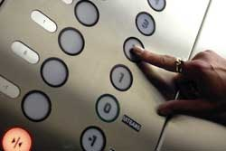
Converting User Input
If we want to read a number from the user, we must convert it from a string to a number using a type conversion function
Later we will deal with bad input data
inp = input('Europe floor?')
usf = int(inp) + 1
print('US floor', usf)
Europe floor? 0
US floor 1

Slide 40
Comments in Python
Anything after a # is ignored by Python
Why comment?
- Describe what is going to happen in a sequence of code
- Document who wrote the code or other ancillary information
- Turn off a line of code - perhaps temporarily

Slide 41
# Get the name of the file and open it
name = input('Enter file:')
handle = open(name, 'r')
# Count word frequency
counts = dict()
for line in handle:
words = line.split()
for word in words:
counts[word] = counts.get(word,0) + 1
# Find the most common word
bigcount = None
bigword = None
for word,count in counts.items():
if bigcount is None or count > bigcount:
bigword = word
bigcount = count
# All done
print(bigword, bigcount)

Slide 42
Summary
Type
Reserved words
Variables (mnemonic)
Operators
Operator precedence
Integer Division
Conversion between types
User input
Comments (#)

Slide 43
Conditional Execution
Chapter 3
Python for Everybody
www.py4e.com
Notes:
Note from Chuck. If you are using these materials, you can remove the UM logo and replace it with your own, but please retain the CC-BY logo on the first page as well as retain the acknowledgement page(s).

Slide 44
Conditional Steps
x = 5
x < 10 ?
Yes
Program:
x = 5
if x < 10:
print('Smaller')
if x > 20:
print('Bigger')
print('Finis')
No
print('Smaller')
Output:
Smaller
Finis
x > 20 ?
Yes
No
print('Bigger')
print('Finis')

Slide 45
Comparison Operators
Boolean expressions ask a question and produce a Yes or No result which we use to control program flow
Boolean expressions using comparison operators evaluate to True / False or Yes / No
Comparison operators look at variables but do not change the variables
Python | Meaning
< | Less than
<= | Less than or Equal to
== | Equal to
>= | Greater than or Equal to
> | Greater than
!= | Not equal
Remember: “=” is used for assignment.
http://en.wikipedia.org/wiki/George_Boole

Slide 46
Comparison Operators
x = 5
if x == 5 :
print('Equals 5')
if x > 4 :
print('Greater than 4')
if x >= 5 :
print('Greater than or Equals 5')
if x < 6 : print('Less than 6')
if x <= 5 :
print('Less than or Equals 5')
if x != 6 :
print('Not equal 6')
Equals 5
Greater than 4
Greater than or Equals 5
Less than 6
Less than or Equals 5
Not equal 6

Slide 47
One-Way Decisions
x = 5
print('Before 5')
if x == 5 :
print('Is 5')
print('Is Still 5')
print('Third 5')
print('Afterwards 5')
print('Before 6')
if x == 6 :
print('Is 6')
print('Is Still 6')
print('Third 6')
print('Afterwards 6')
Yes
x == 5 ?
Before 5
Is 5
Is Still 5
Third 5
Afterwards 5
Before 6
Afterwards 6
No
print('Is 5’)
print('Still 5')
print('Third 5')

Slide 48
Indentation
Increase indent indent after an if statement or for statement (after : )
Maintain indent to indicate the scope of the block (which lines are affected by the if/for)
Reduce indent back to the level of the if statement or for statement to indicate the end of the block
Blank lines are ignored - they do not affect indentation
Comments on a line by themselves are ignored with regard to indentation

Slide 49
Warning: Turn Off Tabs!!
Atom automatically uses spaces for files with ".py" extension (nice!)
Most text editors can turn tabs into spaces - make sure to enable this feature
- NotePad++: Settings -> Preferences -> Language Menu/Tab Settings
- TextWrangler: TextWrangler -> Preferences -> Editor Defaults
Python cares a *lot* about how far a line is indented. If you mix tabs and spaces, you may get “indentation errors” even if everything looks fine

Slide 50
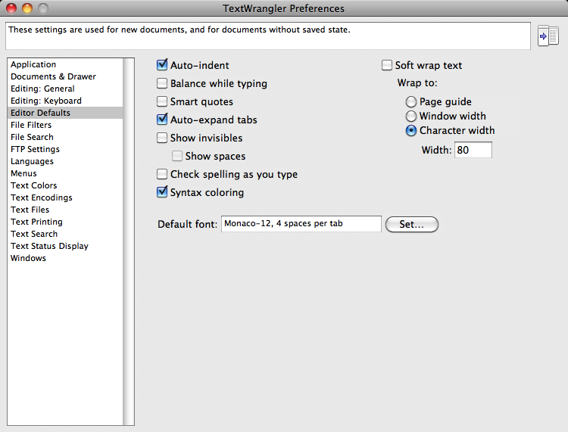

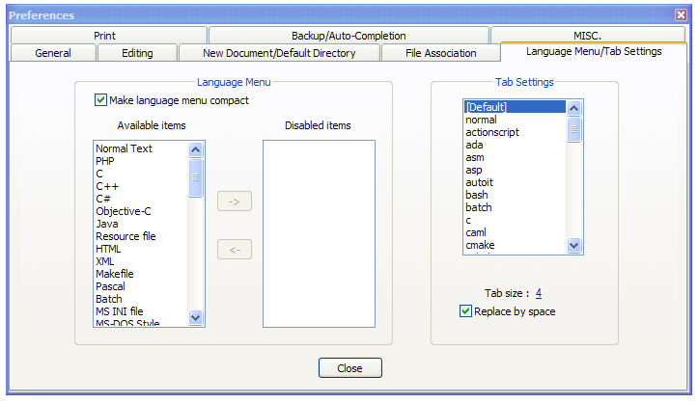
This will save you much unnecessary pain.

Slide 51
increase / maintain after if or for
decrease to indicate end of block
x = 5
if x > 2 :
print('Bigger than 2')
print('Still bigger')
print('Done with 2')
for i in range(5) :
print(i)
if i > 2 :
print('Bigger than 2')
print('Done with i', i)
print('All Done')

Slide 52
Think About begin/end Blocks
x = 5
if x > 2 :
print('Bigger than 2')
print('Still bigger')
print('Done with 2')
for i in range(5) :
print(i)
if i > 2 :
print('Bigger than 2')
print('Done with i', i)
print('All Done')

Slide 53
Nested Decisions
x > 1
yes
no
print('More than one’)
x = 42
if x > 1 :
print('More than one')
if x < 100 :
print('Less than 100')
print('All done')
x < 100
yes
no
print('Less than 100')
print('All Done')

Slide 54
Two-way Decisions
x = 4
Sometimes we want to do one thing if a logical expression is true and something else if the expression is false
It is like a fork in the road - we must choose one or the other path but not both
no
x > 2
yes
print('Not bigger')
print('Bigger')
print('All Done')

Slide 55
Two-way Decisions with else:
x = 4
no
x > 2
yes
x = 4
if x > 2 :
print('Bigger')
else :
print('Smaller')
print('All done')
print('Not bigger')
print('Bigger')
print('All Done')

Slide 56
Visualize Blocks
x = 4
no
x > 2
yes
x = 4
if x > 2 :
print('Bigger')
else :
print('Smaller')
print('All done')
print('Not bigger')
print('Bigger')
print('All Done')

Slide 57
More Conditional Structures…

Slide 58
Multi-way
yes
x < 2
print('small')
if x < 2 :
print('small')
elif x < 10 :
print('Medium')
else :
print('LARGE')
print('All done')
no
yes
x < 10
print('Medium')
no
print('LARGE')
print('All Done')

Slide 59
Multi-way
x = 0
yes
x < 2
print('small')
x = 0
if x < 2 :
print('small')
elif x < 10 :
print('Medium')
else :
print('LARGE')
print('All done')
no
yes
x < 10
print('Medium')
no
print('LARGE')
print('All Done')

Slide 60
Multi-way
x = 5
yes
x < 2
print('small')
x = 5
if x < 2 :
print('small')
elif x < 10 :
print('Medium')
else :
print('LARGE')
print('All done')
no
yes
x < 10
print('Medium')
no
print('LARGE')
print('All Done')

Slide 61
Multi-way
x = 20
yes
x < 2
print('small')
x = 20
if x < 2 :
print('small')
elif x < 10 :
print('Medium')
else :
print('LARGE')
print('All done')
no
yes
x < 10
print('Medium')
no
print('LARGE')
print('All Done')

Slide 62
Multi-way
if x < 2 :
print('Small')
elif x < 10 :
print('Medium')
elif x < 20 :
print('Big')
elif x < 40 :
print('Large')
elif x < 100:
print('Huge')
else :
print('Ginormous')
# No Else
x = 5
if x < 2 :
print('Small')
elif x < 10 :
print('Medium')
print('All done')

Slide 63
Multi-way Puzzles
Which will never print regardless of the value for x?
if x < 2 :
print('Below 2')
elif x < 20 :
print('Below 20')
elif x < 10 :
print('Below 10')
else :
print('Something else')
if x < 2 :
print('Below 2')
elif x >= 2 :
print('Two or more')
else :
print('Something else')

Slide 64
The try / except Structure
You surround a dangerous section of code with try and except
If the code in the try works - the except is skipped
If the code in the try fails - it jumps to the except section

Slide 65
$ python3 notry.py
Traceback (most recent call last): File "notry.py", line 2, in <module> istr = int(astr)ValueError: invalid literal for int() with base 10: 'Hello Bob'
$ cat notry.py
astr = 'Hello Bob'
istr = int(astr)
print('First', istr)
astr = '123'
istr = int(astr)
print('Second', istr)
All
Done

Slide 66
$ python3 notry.py
Traceback (most recent call last): File "notry.py", line 2, in <module> istr = int(astr)ValueError: invalid literal for int() with base 10: 'Hello Bob'
The program stops here
$ cat notry.py
astr = 'Hello Bob'
istr = int(astr)
print('First', istr)
astr = '123'
istr = int(astr)
print('Second', istr)
All
Done

Slide 67
Generic
Computer
Software
Input
Devices
Central
Processing
Unit
Secondary
Memory
Output
Devices
Main
Memory
Notes:
Who has see a traceback in CTools?

Slide 68
Generic
Computer
Software
Input
Devices
Central
Processing
Unit
Secondary
Memory
Output
Devices
Main
Memory
Notes:
Who has see a traceback in CTools?

Slide 69
astr = 'Hello Bob'
try:
istr = int(astr)
except:
istr = -1
print('First', istr)
astr = '123'
try:
istr = int(astr)
except:
istr = -1
print('Second', istr)
When the first conversion fails - it just drops into the except: clause and the program continues.
$ python tryexcept.py
First -1
Second 123
When the second conversion succeeds - it just skips the except: clause and the program continues.

Slide 70
try / except
astr = 'Bob'
print('Hello')
astr = 'Bob'
try:
print('Hello')
istr = int(astr)
print('There')
except:
istr = -1
print('Done', istr)
istr = int(astr)
print('There')
istr = -1
print('Done', istr)
Safety net

Slide 71
Sample try / except
rawstr = input('Enter a number:')
try:
ival = int(rawstr)
except:
ival = -1
if ival > 0 :
print('Nice work')
else:
print('Not a number')
$ python3 trynum.py
Enter a number:42
Nice work
$ python3 trynum.py
Enter a number:forty-two
Not a number
$

Slide 72
Summary
Comparison operators == <= >= > < !=
Indentation
One-way Decisions
Two-way decisions: if: and else:
Nested Decisions
Multi-way decisions using elif
try / except to compensate for errors

Slide 73
Acknowledgements / Contributions
These slides are Copyright 2010- Charles R. Severance (www.dr-chuck.com) of the University of Michigan School of Information and made available under a Creative Commons Attribution 4.0 License. Please maintain this last slide in all copies of the document to comply with the attribution requirements of the license. If you make a change, feel free to add your name and organization to the list of contributors on this page as you republish the materials.
Initial Development: Charles Severance, University of Michigan School of Information
… Insert new Contributors and Translators here
...

